Slide 1

Introduction to Oracle11g: SQL
Electronic Presentation
40049GC11
Production 1.1
October 2018 D33996

Slide 2
Objectives
After completing this lesson, you should be able
to do the following:
List the features of Oracl11g
Discuss the theoretical and physical aspects of
a relational database
Describe the Oracle implementation of the
RDBMS and ORDBMS

Slide 3
Relational and Object Relational Database Management System
Relational model and object relational model
User-defined data types and objects
Fully compatible with relational database
Support of multimedia and large objects
High-quality database server features

Slide 4












Oracle Internet Platform
Clients
Any browser
Any mail
client
Any FTP client
System management
Development tools
Internet applications
S_{S}Q_{Q}L_{L}
Business logic and data
Presentation and business logic
P_{P}L_{L}//S_{S}Q_{Q}L L
Application
servers
Databases
Java
Network services

Slide 5

System Development Life Cycle
Strategy and analysis
Design
Build
and
document
Transition
Production

Slide 6
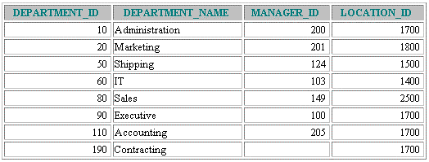
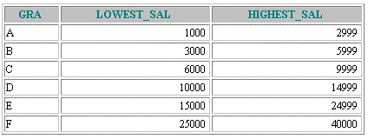
Data Storage on Different Media
Database
Electronic
spreadsheet
Filing cabinet

Slide 7
Relational Database Concept
Dr. E.F. Codd proposed the relational model for
database systems in 1970.
It is the basis for the relational database management system (RDBMS).
The relational model consists of the following:
Collection of objects or relations
Set of operators to act on the relations
Data integrity for accuracy and consistency

Slide 8



Definition of a Relational Database
A relational database is a collection of relations or
two-dimensional tables.
Oracle
server
Table Name: EMPLOYEES
Table Name: DEPARTMENTS
…
…

Slide 9









Data Models
Model of system in client’s mind
Entity model of
client’s model
Table model of entity model
Oracle
server
Tables on disk

Slide 10


Entity Relationship Model
Create an entity relationship diagram from
business specifications or narratives
EMPLOYEE DEPARTMENT
assigned to
#*
number name job title
#*
number name location
*
o
*
o
composed of
Scenario
“. . . Assign one or more employees to a
department . . .”
“. . . Some departments do not yet have assigned
employees . . .”

Slide 11


Entity Relationship Modeling Conventions
Entity Soft box
Attribute Singular name
Singular, unique name Uppercase
Synonym in parentheses
Lowercase
Mandatory marked with “*”
Optional marked with “o”
EMPLOYEE
DEPARTMENT
assigned to
#*
number name job title
#*
number name location
* o
* o
composed of
Unique Identifier (UID) Primary marked with “#” Secondary marked with “(#)”

Slide 12
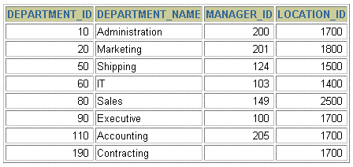
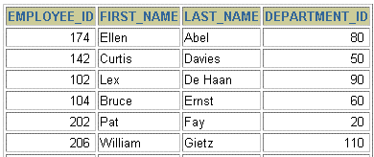
Relating Multiple Tables
Each row of data in a table is uniquely
identified by a primary key (PK).
You can logically relate data from multiple tables using foreign keys (FK).
Table Name: DEPARTMENTS
Table Name: EMPLOYEES
…
Primary key
Foreign key
Primary key

Slide 13
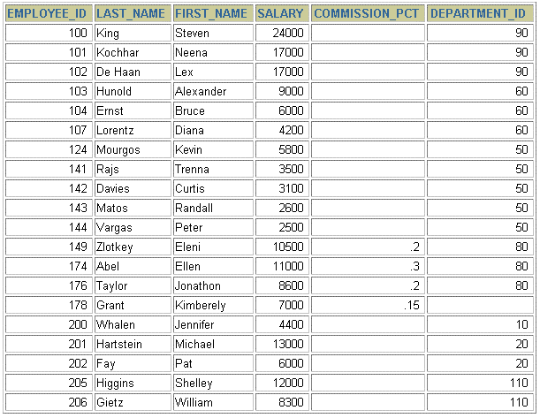
Relational Database Terminology
3
4
2
 |  |  | 5
6
1

Slide 14
Relational Database Properties
A relational database:
Can be accessed and modified by executing
structured query language (SQL) statements
Contains a collection of tables with no physical
pointers
Uses a set of operators

Slide 15

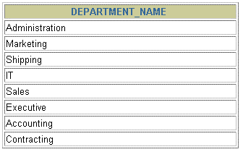

Communicating with a RDBMS Using SQL
SQL statement
is entered.
Statement is sent to
Oracle Server.
SELECT department_name FROM departments;
Oracle

Slide 16










Relational Database Management System
User tables
Data
dictionary

Slide 17
SQL Statements
SELECT
Data retrieval
INSERT UPDATE DELETE MERGE
Data manipulation language (DML)
CREATE ALTER DROP RENAME TRUNCATE
Data definition language (DDL)
COMMIT ROLLBACK SAVEPOINT
Transaction control
GRANT
REVOKE
Data control language (DCL)

Slide 18
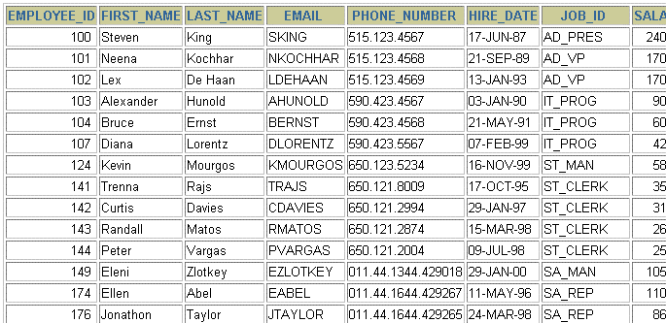
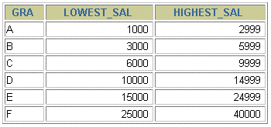
Tables Used in the Course
EMPLOYEES
DEPARTMENTS
JOB_GRADES

Slide 19
Summary
The Oracle9i Server is the database for Internet
computing.
Oracle9i is based on the object relational database management system.
Relational databases are composed of relations, managed by relational operations, and governed by data integrity constraints.
With the Oracle Server, you can store and manage information by using the SQL language and PL/SQL engine.

Slide 20
Writing Basic
SQL SELECT Statements

Slide 21
Objectives
After completing this lesson, you should be able to
do the following:
List the capabilities of SQL SELECT statements
Execute a basic SELECT statement
Differentiate between SQL statements and
iSQL*Plus commands

Slide 22
Capabilities of SQL SELECT Statements
Projection
Selection
Table 1
Table 1
Join
Table 1
Table 2

Slide 23
Basic SELECT Statement
SELECT FROM
*|{[DISTINCT] column|expression [alias],...}
table;
SELECT identifies what columns
FROM identifies which table

Slide 24
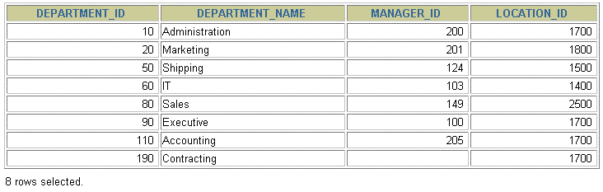
Selecting All Columns
SELECT *
FROM departments;

Slide 25
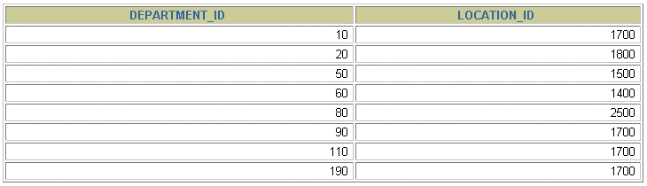
Selecting Specific Columns
SELECT
FROM departments;
department_id, location_id

Slide 26
Writing SQL Statements
SQL statements are not case sensitive.
SQL statements can be on one or more lines.
Keywords cannot be abbreviated or split
across lines.
Clauses are usually placed on separate lines.
Indents are used to enhance readability.

Slide 27
Column Heading Defaults
iSQL*Plus:
Default heading justification: Center
Default heading display: Uppercase
SQL*Plus:
Character and Date column headings are left- justified
Number column headings are right-justified
Default heading display: Uppercase

Slide 28
Arithmetic Expressions
Create expressions with number and date data by
using arithmetic operators.
Operator
Description
+ Add
- Subtract
* Multiply
/ Divide

Slide 29
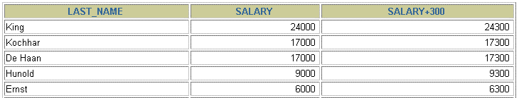
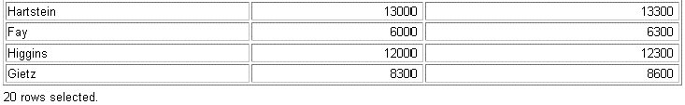
Using Arithmetic Operators
SELECT last_name, salary, FROM employees;
salary + 300
…

Slide 30
Operator Precedence
_
*
/ +
Multiplication and division take priority over
addition and subtraction.
Operators of the same priority are evaluated from
left to right.
Parentheses are used to force prioritized evaluation and to clarify statements.

Slide 31
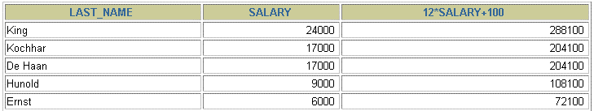
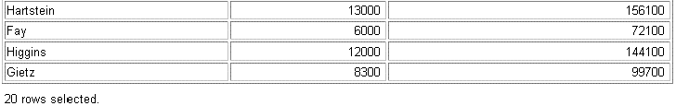
Operator Precedence
SELECT last_name, salary, FROM employees;
12*salary+100
…

Slide 32
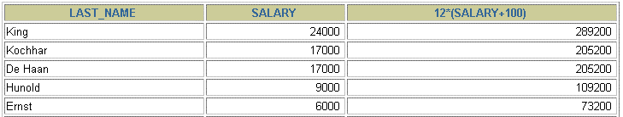

Using Parentheses
SELECT last_name, salary, FROM employees;
12*(salary+100)
…

Slide 33
Defining a Null Value
A null is a value that is unavailable, unassigned,
unknown, or inapplicable.
A null is not the same as zero or a blank space.
SELECT last_name, job_id, salary, commission_pct
FROM employees;
…
…

Slide 34
Null Values
in Arithmetic Expressions
Arithmetic expressions containing a null value
evaluate to null.
SELECT last_name, 12*salary*commission_pct FROM employees;
…
…

Slide 35
Defining a Column Alias
A column alias:
Renames a column heading
Is useful with calculations
Immediately follows the column name - there can also be the optional AS keyword between the column name and alias
Requires double quotation marks if it contains spaces or special characters or is case sensitive

Slide 36


Using Column Aliases
SELECT last_name AS name, commission_pct comm
FROM employees;
…
SELECT last_name "Name", salary*12
FROM employees;
"Annual Salary"
…

Slide 37
Concatenation Operator
A concatenation operator:
Concatenates columns or character strings to
other columns
Is represented by two vertical bars (||)
Creates a resultant column that is a character
expression

Slide 38
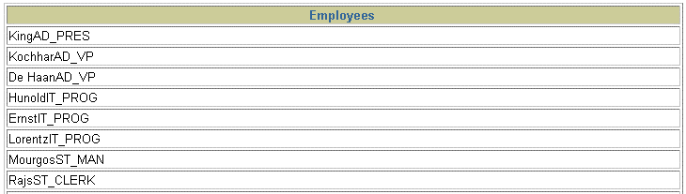
Using the Concatenation Operator
SELECT FROM
last_name||job_id AS "Employees" employees;
…

Slide 39
Literal Character Strings
A literal is a character, a number, or a date
included in the SELECT list.
Date and character literal values must be enclosed within single quotation marks.
Each character string is output once for each row returned.

Slide 40
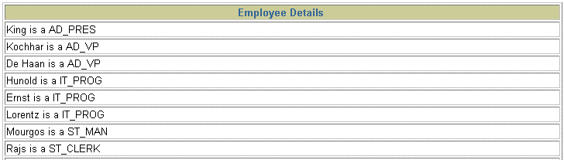
Using Literal Character Strings
SELECT last_name ||' is a '||job_id
AS "Employee Details"
FROM employees;
…

Slide 41
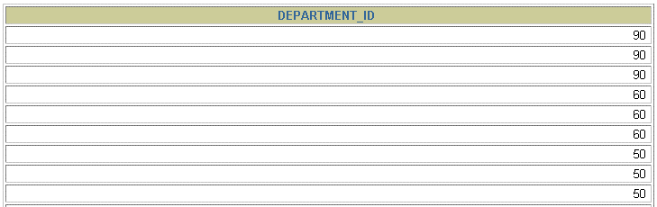
Duplicate Rows
The default display of queries is all rows, including duplicate rows.
SELECT department_id FROM employees;
…

Slide 42
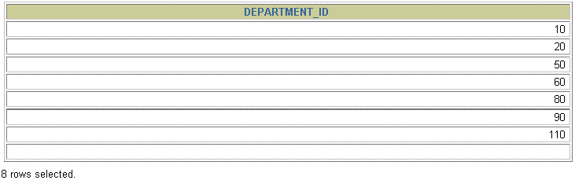
Eliminating Duplicate Rows
Eliminate duplicate rows by using the DISTINCT
keyword in the SELECT clause.
SELECT department_id FROM employees;
DISTINCT

Slide 43



SQL and iSQL*Plus Interaction
SQL statements
iSQL*Plus Internet Browser
iSQL*Plus
commands
Query results
Formatted report
Client

Slide 44
SQL Statements Versus
iSQL*Plus Commands
SQL
A language
ANSI standard
Keyword cannot be
abbreviated
Statements manipulate data and table definitions in the database
iSQL*Plus
An environment
Oracle proprietary
Keywords can be
abbreviated
Commands do not allow manipulation of values in the database
Runs on a browser
Centrally loaded, does not have to be implemented on each machine
iSQL*Plus commands
SQL
statements

Slide 45
Overview of iSQL*Plus
After you log into iSQL*Plus, you can:
Describe the table structure
Edit your SQL statement
Execute SQL from iSQL*Plus
Save SQL statements to files and append SQL statements to files
Execute statements stored in saved files
Load commands from a text file into the iSQL*Plus
Edit window

Slide 46
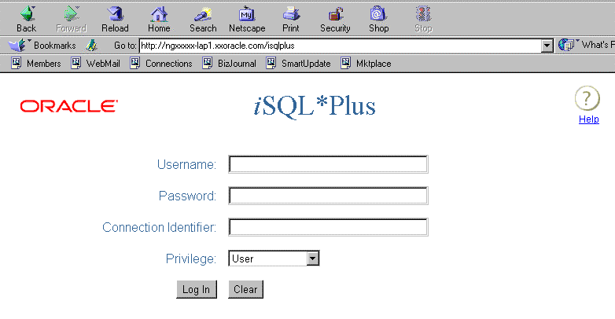
Logging In to iSQL*Plus
From your Windows browser environment:

Slide 47
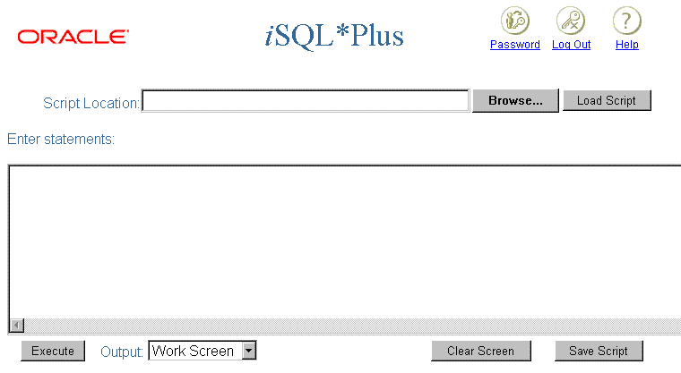

The iSQL*Plus Environment
10 8
9
6
1
2
3
4
5

Slide 48
Displaying Table Structure
Use the iSQL*Plus DESCRIBE command to display the structure of a table.
DESC[RIBE] tablename

Slide 49
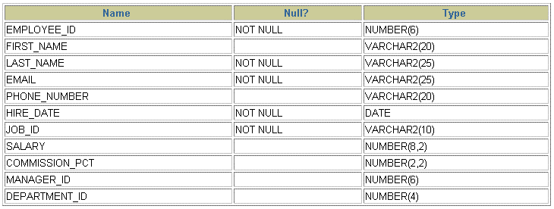
Displaying Table Structure
DESCRIBE employees

Slide 50
Summary
In this lesson, you should have learned how to:
Write a SELECT statement that:
Returns all rows and columns from a table
Returns specified columns from a table
Uses column aliases to give descriptive column
headings
Use the iSQL*Plus environment to write, save, and
execute SQL statements and iSQL*Plus commands.
SELECT
FROM
*|{[DISTINCT] column|expression [alias],...}
table;

Slide 51
Practice Overview
This practice covers the following topics:
Selecting all data from different tables
Describing the structure of tables
Performing arithmetic calculations and specifying
column names
Using iSQL*Plus

Slide 52
Restricting and Sorting Data
CCooppyyrriigghhtt ©© OOrraaccllee CCoorrppoorraattiioonn,, 22001081.. AAllll rriigghhttss rreesseerrvveedd..

Slide 53
Objectives
After completing this lesson, you should be able to
do the following:
Limit the rows retrieved by a query
Sort the rows retrieved by a query

Slide 54
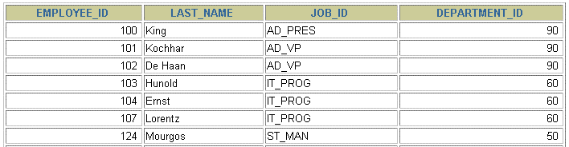


Limiting Rows Using a Selection
EMPLOYEES
…
“retrieve all employees
in department 90”

Slide 55
Limiting the Rows Selected
Restrict the rows returned by using the WHERE
clause.
SELECT FROM
*|{[DISTINCT] column|expression [alias],...}
table
[WHERE condition(s)];
The WHERE clause follows the FROM clause.

Slide 56

Using the WHERE Clause
SELECT employee_id, last_name, job_id, department_id
FROM employees
;
WHERE department_id = 90

Slide 57
Character Strings and Dates
Character strings and date values are enclosed in
single quotation marks.
Character values are case sensitive, and date values are format sensitive.
The default date format is DD-MON-RR.
SELECT last_name, job_id, department_id
FROM employees
WHERE last_name = 'Whalen';

Slide 58
Comparison Conditions
Operator
Meaning
=
Equal to
> Greater than
>=
Greater than or equal to
<
Less than
<=
Less than or equal to
<>
Not equal to

Slide 59

Using Comparison Conditions
SELECT last_name, salary FROM employees
WHERE salary | <= 3000 | ;

Slide 60
Other Comparison Conditions
Operator
Meaning
BETWEEN ...AND... | Between two values (inclusive),
IN(set) | Match any of a list of values
LIKE | Match a character pattern
IS NULL | Is a null value

Slide 61
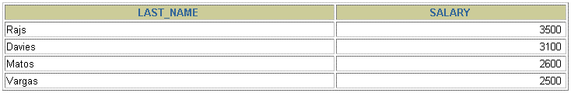
Using the BETWEEN Condition
Use the BETWEEN condition to display rows based on a range of values.
SELECT last_name, salary
FROM employees
WHERE salary BETWEEN 2500 AND 3500;
Lower limit
Upper limit

Slide 62
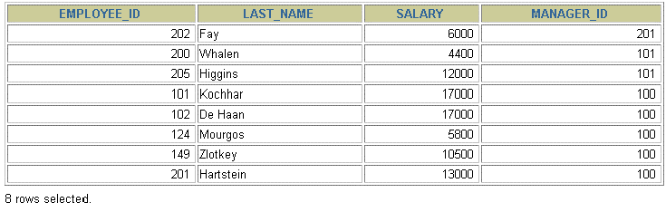
Using the IN Condition
Use the IN membership condition to test for values in
a list.
SELECT employee_id, last_name, salary, manager_id
FROM employees
WHERE manager_id IN (100, 101, 201);

Slide 63
Using the LIKE Condition
Use the LIKE condition to perform wildcard searches of valid search string values.
Search conditions can contain either literal
characters or numbers:
% denotes zero or many characters.
_ denotes one character.
SELECT FROM WHERE
first_name
employees
first_name LIKE 'S%';

Slide 64

Using the LIKE Condition
You can combine pattern-matching characters.
SELECT last_name FROM employees
WHERE last_name | LIKE '_o%';
You can use the ESCAPE identifier to search for the
actual % and _ symbols.

Slide 65
Using the NULL Conditions
Test for nulls with the IS NULL operator.
SELECT last_name, manager_id FROM employees
WHERE manager_id IS NULL;

Slide 66
Logical Conditions
Operator
Meaning
AND
Returns TRUE if both component conditions are true
OR
Returns TRUE if either component
condition is true
NOT
Returns TRUE if the following
condition is false

Slide 67

Using the AND Operator
AND requires both conditions to be true.
SELECT employee_id, last_name, job_id, salary
FROM employees WHERE salary >=10000
AND job_id LIKE '%MAN%';

Slide 68
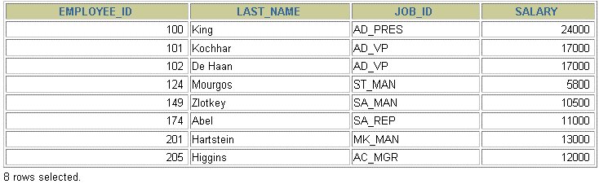
Using the OR Operator
OR requires either condition to be true.
SELECT employee_id, last_name, job_id, salary FROM employees
WHERE salary >= 10000
OR job_id LIKE '%MAN%';

Slide 69
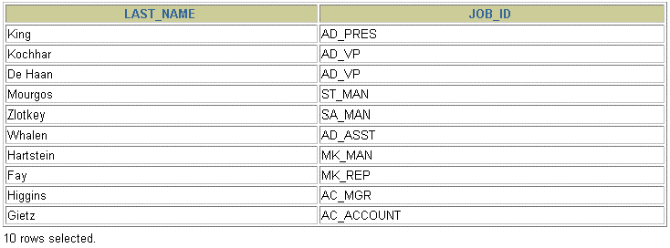
Using the NOT Operator
SELECT last_name, job_id
FROM
WHERE
employees
job_id
NOT IN ('IT_PROG', 'ST_CLERK', 'SA_REP');

Slide 70
Rules of Precedence
Order Evaluated | Operator
1 | Arithmetic operators
2 | Concatenation operator
3 | Comparison conditions
4 | IS [NOT] NULL, LIKE, [NOT] IN
5 | [NOT] BETWEEN
6 | NOT logical condition
7 | AND logical condition
8 | OR logical condition
Override rules of precedence by using parentheses.

Slide 71
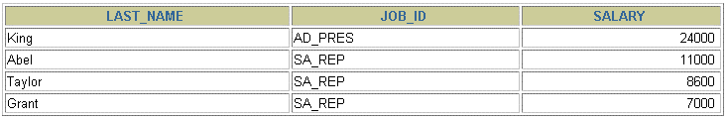
Rules of Precedence
SELECT last_name, job_id, salary
FROM employees
WHERE job_id = 'SA_REP' OR job_id = 'AD_PRES' AND salary > 15000;

Slide 72
Rules of Precedence
Use parentheses to force priority.
SELECT last_name, job_id, salary FROM employees
WHERE (job_id = 'SA_REP' OR job_id = 'AD_PRES') AND salary > 15000;

Slide 73
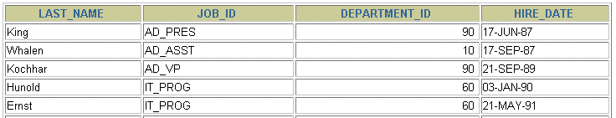
ORDER BY Clause
Sort rows with the ORDER BY clause
ASC: ascending order, default
DESC: descending order
The ORDER BY clause comes last in the SELECT
statement.
SELECT FROM
last_name, job_id, department_id, hire_date employees
;
ORDER BY hire_date
…

Slide 74
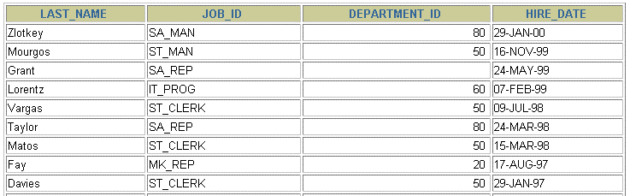
Sorting in Descending Order
SELECT FROM
last_name, job_id, department_id, hire_date employees
ORDER BY hire_date DESC ;
…

Slide 75
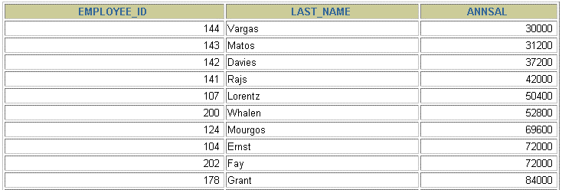
Sorting by Column Alias
SELECT employee_id, last_name, salary*12 FROM employees
ORDER BY annsal;
annsal
…

Slide 76
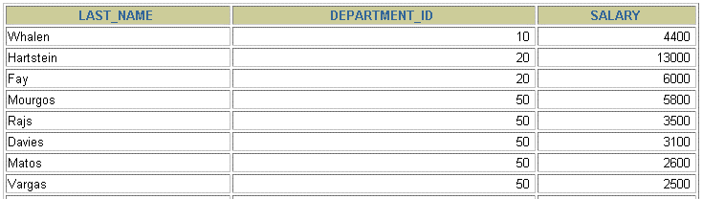
Sorting by Multiple Columns
The order of ORDER BY list is the order of sort.
SELECT last_name, department_id, salary
FROM employees
ORDER BY department_id, salary DESC;
…
You can sort by a column that is not in the
SELECT list.

Slide 77
Summary
In this lesson, you should have learned how to:
Use the WHERE clause to restrict rows of output
Use the comparison conditions
Use the BETWEEN, IN, LIKE, and NULL conditions
Apply the logical AND, OR, and NOT operators
Use the ORDER BY clause to sort rows of output
SELECT FROM [WHERE
*|{[DISTINCT] column|expression [alias],...}
table
condition(s)]
[ORDER BY
{column, expr, alias} [ASC|DESC]];

Slide 78
Practice Overview
This practice covers the following topics:
Selecting data and changing the order of
rows displayed
Restricting rows by using the WHERE clause
Sorting rows by using the ORDER BY clause

Slide 80
Single-Row Functions
CCooppyyrriigghhtt ©© OOrraaccllee CCoorrppoorraattiioonn,, 22001081.. AAllll rriigghhttss rreesseerrvveedd..

Slide 81
Objectives
After completing this lesson, you should be able to
do the following:
Describe various types of functions available in SQL
Use character, number, and date functions in
SELECT statements
Describe the use of conversion functions

Slide 82
SQL Functions
Input
Output
Function
arg 1
Function
performs action
arg 2
Result
value
arg n

Slide 83
Two Types of SQL Functions
Functions
Single-row
functions
Multiple-row
functions

Slide 84
Single-Row Functions
Single row functions:
Manipulate data items
Accept arguments and return one value
Act on each row returned
Return one result per row
May modify the data type
Can be nested
Accept arguments which can be a column or an expression
function_name [(arg1, arg2,...)]

Slide 85
Single-Row Functions
Character
General
Number
Single-row functions
Conversion
Date

Slide 86
Character Functions
Character functions
Case-manipulation
Character-manipulation
functions
LOWER UPPER INITCAP
functions
CONCAT SUBSTR LENGTH INSTR
LPAD | RPAD TRIM
REPLACE

Slide 87
Case Manipulation Functions
These functions convert case for character strings.
Function Result
LOWER('SQL Course') UPPER('SQL Course') INITCAP('SQL Course')
sql course
SQL COURSE
Sql Course

Slide 88
Using Case Manipulation Functions
Display the employee number, name, and department
number for employee Higgins:
SELECT employee_id, last_name, department_id FROM employees
WHERE last_name = 'higgins';
no rowsselected
SELECT employee_id, last_name, department_id FROM employees
WHERE LOWER(last_name) = 'higgins';

Slide 89
Character-Manipulation Functions
These functions manipulate character strings:
Function CONCAT('Hello', 'World') SUBSTR('HelloWorld',1,5) LENGTH('HelloWorld') INSTR('HelloWorld', 'W')
LPAD(salary,10,'*')
RPAD(salary, 10, '*') TRIM('H' FROM 'HelloWorld')
Result HelloWorld Hello
10
6
*****24000
24000*****
elloWorld

Slide 90
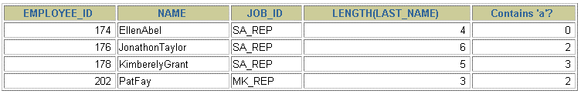
Using the Character-Manipulation Functions
1
SELECT employee_id, CONCAT(first_name, last_name) NAME,
2
3
job_id, LENGTH (last_name),
INSTR(last_name, 'a') employees
"Contains 'a'?"
FROM
WHERE
SUBSTR(job_id, 4) = 'REP';
1
2
3

Slide 91
Number Functions
ROUND: Rounds value to specified decimal
ROUND(45.926, 2) 45.93
TRUNC: Truncates value to specified decimal
TRUNC(45.926, 2) 45.92
MOD: Returns remainder of division
MOD(1600, 300) 100

Slide 92
Using the ROUND Function
1 2
SELECT ROUND(45.923,2), ROUND(45.923,0),
ROUND(45.923,-1)
3
FROM DUAL;
1 2
DUAL is a dummy table you can use to view results from functions and calculations.
3

Slide 93
Using the TRUNC Function
1 2
SELECT
TRUNC(45.923,2) |  | ,
 | TRUNC(45.923,-2)
TRUNC(45.923),
3
FROM
DUAL;
1
2
3

Slide 94

Using the MOD Function
Calculate the remainder of a salary after it is divided by 5000 for all employees whose job title is sales representative.
SELECT last_name, salary,
FROM employees
WHERE job_id = 'SA_REP';
MOD(salary, 5000)

Slide 95

Working with Dates
Oracle database stores dates in an internal numeric format: century, year, month, day, hours, minutes, seconds.
The default date display format is DD-MON-RR.
Allows you to store 21st century dates in the 20th century by specifying only the last two digits of the year.
Allows you to store 20th century dates in the 21st
century in the same way.
SELECT last_name,
FROM employees
WHERE last_name like 'G%';
hire_date

Slide 96
Working with Dates
SYSDATE is a function that returns:
Date
Time

Slide 97
Arithmetic with Dates
Add or subtract a number to or from a date for a
resultant date value.
Subtract two dates to find the number of days between those dates.
Add hours to a date by dividing the number of hours by 24.

Slide 98

Using Arithmetic Operators with Dates
SELECT last_name,
FROM employees
WHERE department_id = 90;
(SYSDATE-hire_date)/7 AS WEEKS

Slide 99
Date Functions
Function
Description
MONTHS_BETWEEN
Number of months
between two dates
ADD_MONTHS
Add calendar months to date
NEXT_DAY
Next day of the date
specified
LAST_DAY
Last day of the month
ROUND
Round date
TRUNC
Truncate date

Slide 100
Using Date Functions
MONTHS_BETWEEN ('01-SEP-95','11-JAN-94')
19.6774194
ADD_MONTHS ('11-JAN-94',6)
'11-JUL-94'
NEXT_DAY ('01-SEP-95','FRIDAY')
'08-SEP-95'
LAST_DAY('01-FEB-95')
'28-FEB-95'

Slide 101
Using Date Functions
Assume SYSDATE = '25-JUL-95':
ROUND(SYSDATE,'MONTH')
01-AUG-95
ROUND(SYSDATE ,'YEAR')
01-JAN-96
TRUNC(SYSDATE ,'MONTH')
01-JUL-95
TRUNC(SYSDATE ,'YEAR')
01-JAN-95

Slide 102
Aggregating Data Using Group Functions
CCooppyyrriigghhtt ©© OOrraaccllee CCoorrppoorraattiioonn,, 22001081.. AAllll rriigghhttss rreesseerrvveedd..

Slide 103
Objectives
After completing this lesson, you should be able to
do the following:
Identify the available group functions
Describe the use of group functions
Group data using the GROUP BY clause
Include or exclude grouped rows by using the
HAVING clause

Slide 104
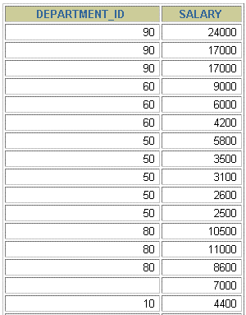

What Are Group Functions?
Group functions operate on sets of rows to give one result per group.
EMPLOYEES
The maximum salary in
the EMPLOYEES
table.
…

Slide 105
Types of Group Functions
AVG
COUNT
MAX
MIN
STDDEV
SUM
VARIANCE

Slide 106
Group Functions Syntax
SELECT FROM [WHERE [GROUP BY [ORDER BY
[column,] group_function(column), ...
table
condition] column] column];

Slide 107
Using the AVG and SUM Functions
You can use AVG and SUM for numeric data.
SELECT
AVG(salary), MAX(salary),
MIN(salary), SUM(salary)
FROM WHERE
employees
job_id LIKE '%REP%';

Slide 108
Using the MIN and MAX Functions
You can use MIN and MAX for any data type.
SELECT | MIN(hire_date), MAX(hire_date)
FROM employees;

Slide 109
Using the COUNT Function
COUNT(*) returns the number of rows in a table.
SELECT | COUNT(*)
FROM employees WHERE department_id = 50;

Slide 110
Using the COUNT Function
COUNT(expr) returns the number of rows with
non-null values for the expr.
Display the number of department values in the
EMPLOYEES table, excluding the null values.
SELECT
FROM employees
WHERE department_id = 80;
COUNT(commission_pct)

Slide 111
Using the DISTINCT Keyword
COUNT(DISTINCT expr) returns the number of
distinct non-null values of the expr.
Display the number of distinct department values
in the EMPLOYEES table.
SELECT | COUNT(DISTINCT department_id)
FROM employees;

Slide 112
Group Functions and Null Values
Group functions ignore null values in the column.
SELECT
FROM employees;
AVG(commission_pct)

Slide 113
Using the NVL Function with Group Functions
The NVL function forces group functions to include null values.
SELECT
FROM employees;
AVG(NVL(commission_pct, 0))

Slide 114
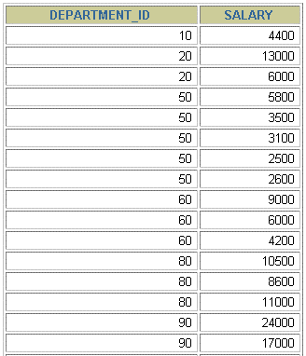
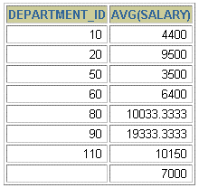
Creating Groups of Data
EMPLOYEES
4400
9500
The
average
salary
3500
in
EMPLOYEES
table
6400
for each
department.
10033
…

Slide 115
Creating Groups of Data: The GROUP BY Clause Syntax
SELECT FROM [WHERE
column, group_function(column) table
condition]
[GROUP BY group_by_expression]
[ORDER BY column];
Divide rows in a table into smaller groups by using the
GROUP BY clause.

Slide 116
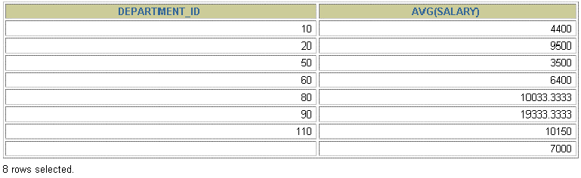
Using the GROUP BY Clause
All columns in the SELECT list that are not in group
functions must be in the GROUP BY clause.
SELECT FROM
department_id, employees
AVG(salary)
GROUP BY department_id ;

Slide 117
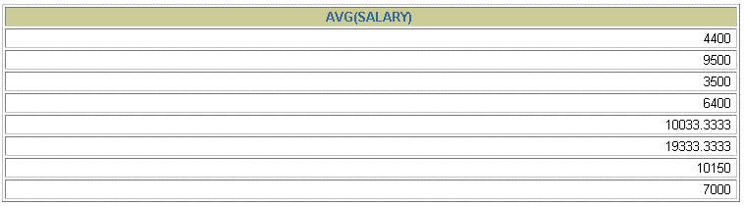
Using the GROUP BY Clause
The GROUP BY column does not have to be in the
SELECT list.
SELECT AVG(salary) FROM employees
 | GROUP BY department_id | ;

Slide 118
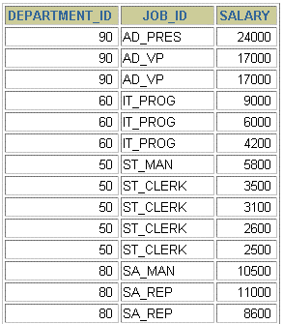
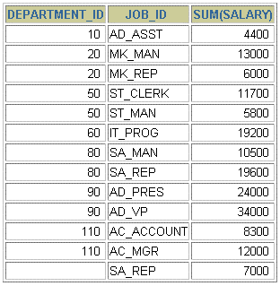

Grouping by More Than One Column
EMPLOYEES
“Add up the
salaries in
the EMPLOYEES
table for each job, grouped by department.
…

Slide 119
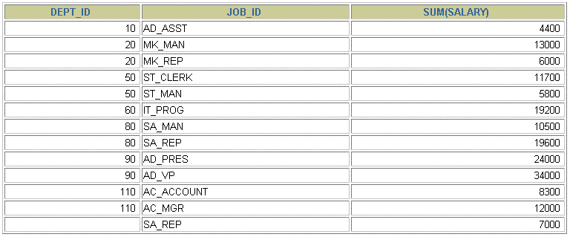
Using the GROUP BY Clause on Multiple Columns
SELECT FROM
department_id dept_id, job_id, SUM(salary) employees
;
GROUP BY department_id, job_id

Slide 120
Illegal Queries Using Group Functions
Any column or expression in the SELECT list that is not an aggregate function must be in the GROUP BY clause.
SELECT department_id, COUNT(last_name)
FROM employees;
SELECT department_id, COUNT(last_name)
*
ERROR at line 1:
ORA-00937: not a single-group group function
Column missing in the GROUP BY clause

Slide 121
Illegal Queries Using Group Functions
You cannot use the WHERE clause to restrict groups.
You use the HAVING clause to restrict groups.
You cannot use group functions in the WHERE clause.
SELECT FROM WHERE
department_id, AVG(salary)
employees
AVG(salary) > 8000
GROUP BY department_id;
WHERE AVG(salary) > 8000
*
ERROR at line 3:
ORA-00934: group function is not allowed here
Cannot use the WHERE clause to restrict groups

Slide 122
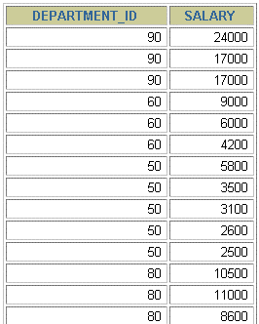
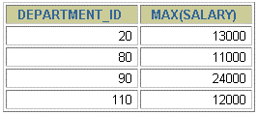

Excluding Group Results
EMPLOYEES
The maximum
salary
per department when it is greater than
$10,000
…

Slide 123
Excluding Group Results: The HAVING
Clause
Use the HAVING clause to restrict groups:
Rows are grouped.
The group function is applied.
Groups matching the HAVING clause are displayed.
SELECT FROM [WHERE [GROUP BY [HAVING
column, group_function
table
condition] group_by_expression]
group_condition] column];
[ORDER BY

Slide 124
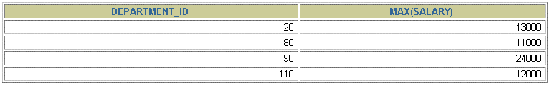
Using the HAVING Clause
SELECT department_id, MAX(salary) FROM employees GROUP BY department_id
 | HAVING MAX(salary)>10000 | ;

Slide 125

Using the HAVING Clause
SELECT FROM WHERE
job_id, SUM(salary) PAYROLL
employees
job_id NOT LIKE '%REP%'
GROUP BY job_id
HAVING SUM(salary) > 13000
ORDER BY SUM(salary);

Slide 126
Nesting Group Functions
Display the maximum average salary.
SELECT FROM
MAX(AVG(salary))
employees
GROUP BY department_id;

Slide 127
Summary
In this lesson, you should have learned how to:
Use the group functions COUNT, MAX, MIN, AVG
Write queries that use the GROUP BY clause
Write queries that use the HAVING clause
SELECT FROM [WHERE
column, group_function(column) table
condition]
[GROUP BY [HAVING [ORDER BY
group_by_expression] group_condition] column];

Slide 128
Part One: Overview
This practice covers the following topics:
Writing a query that displays the current date
Creating queries that require the use of numeric,
character, and date functions
Performing calculations of years and months of
service for an employee

Slide 129
Conversion Functions
Data type
conversion
Implicit data type
conversion
Explicit data type
conversion

Slide 130
Implicit Data Type Conversion
For assignments, the Oracle server can automatically
convert the following:
From To
VARCHAR2 or CHAR NUMBER
VARCHAR2 or CHAR DATE
NUMBER VARCHAR2
DATE VARCHAR2

Slide 131
Implicit Data Type Conversion
For expression evaluation, the Oracle Server can
automatically convert the following:
From
To
VARCHAR2 or CHAR
NUMBER
VARCHAR2 or CHAR
DATE

Slide 132








Explicit Data Type Conversion
TO_NUMBER
TO_DATE
NUMBER
CHARACTER
DATE
TO_CHAR
TO_CHAR

Slide 133
Explicit Data Type Conversion
TO_NUMBER
TO_DATE
NUMBER
CHARACTER
DATE
TO_CHAR
TO_CHAR

Slide 134
Using the TO_CHAR Function with Dates
TO_CHAR(date, 'format_model')
The format model:
Must be enclosed in single quotation marks and is case
sensitive
Can include any valid date format element
Has an fm element to remove padded blanks or
suppress leading zeros
Is separated from the date value by a comma

Slide 135
Elements of the Date Format Model
YYYY
Full year in numbers
YEAR
Year spelled out
MM
Two-digit value for month
MONTH
Full name of the month
Three-letter abbreviation of the month
MON
Three-letter abbreviation of the day of the week
DY
DAY
Full name of the day of the week
DD
Numeric day of the month

Slide 136
Elements of the Date Format Model
Time elements format the time portion of the date.
HH24:MI:SS AM 15:45:32 PM
Add character strings by enclosing them in double
quotation marks.
DD "of" MONTH 12 of OCTOBER
Number suffixes spell out numbers.
ddspth fourteenth
3-34
Copyright © Oracle Corporation, 2018. All rights reserved.

Slide 137
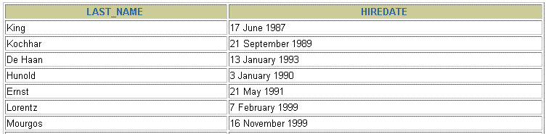
Using the TO_CHAR Function with Dates
SELECT last_name,
TO_CHAR(hire_date, 'fmDD Month YYYY')
AS HIREDATE
FROM
employees;
…

Slide 138
Using the TO_CHAR Function with Numbers
TO_CHAR(number, 'format_model')
These are some of the format elements you can use with the TO_CHAR function to display a number value as a character:
9 Represents a number
0 Forces a zero to be displayed
$ Places a floating dollar sign
L Uses the floating local currency symbol
. Prints a decimal point
,
Prints a thousand indicator

Slide 139
Using the TO_CHAR Function with Numbers
SELECT
FROM employees
WHERE last_name = 'Ernst';
TO_CHAR(salary, '$99,999.00') SALARY

Slide 140
Using the TO_NUMBER and TO_DATE
Functions
Convert a character string to a number format
using the TO_NUMBER function:
TO_NUMBER(char[, 'format_model'])
Convert a character string to a date format using
the TO_DATE function:
TO_DATE(char[, 'format_model'])
These functions have an fx modifier. This modifier specifies the exact matching for the character argument and date format model of a TO_DATE function

Slide 141
Using the TO_NUMBER and TO_DATE
Functions
Convert a character string to a number format
using the TO_NUMBER function:
TO_NUMBER(char[, 'format_model'])
Convert a character string to a date format using
the TO_DATE function:
TO_DATE(char[, 'format_model'])
These functions have an fx modifier. This modifier specifies the exact matching for the character argument and date format model of a TO_DATE function

Slide 142
Nesting Functions
Single-row functions can be nested to any level.
Nested functions are evaluated from deepest level
to the least deep level.
F3(F2(F1(col,arg1),arg2),arg3)
Step 1 = Result 1
Step 2 = Result 2
Step 3 = Result 3

Slide 143
Nesting Functions
SELECT last_name,
NVL(TO_CHAR(manager_id), 'No Manager')
FROM
WHERE
employees
manager_id IS NULL;

Slide 144
General Functions
These functions work with any data type and pertain
to using nulls.
NVL (expr1, expr2)
NVL2 (expr1, expr2, expr3)
NULLIF (expr1, expr2)
COALESCE (expr1, expr2, ..., exprn)

Slide 145
NVL Function
Converts a null to an actual value.
Data types that can be used are date, character,
and number.
Data types must match:
NVL(commission_pct,0)
NVL(hire_date,'01-JAN-97')
NVL(job_id,'No Job Yet')

Slide 146
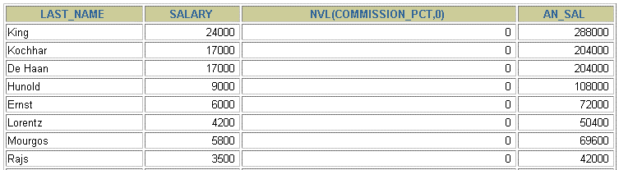
Using the NVL Function
1
SELECT last_name, salary, NVL(commission_pct, 0),
(salary*12) + (salary*12*NVL(commission_pct, 0)) AN_SAL
2
FROM employees;
…
1
2

Slide 147
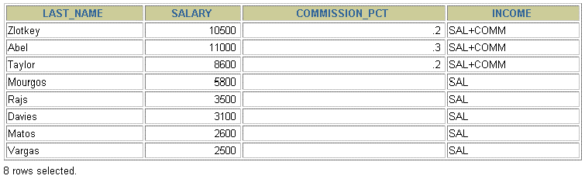
Using the NVL2 Function
1
SELECT last_name, salary, commission_pct, NVL2(commission_pct,
'SAL+COMM', 'SAL') income
2
FROM employees WHERE department_id IN (50, 80);
1
2

Slide 148
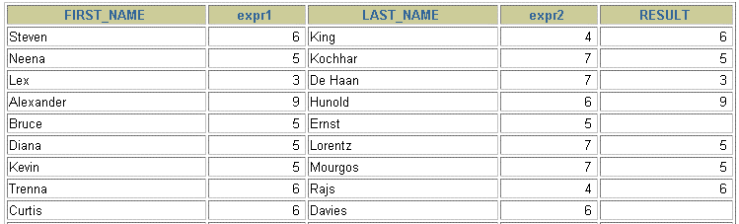
Using the NULLIF Function
1
SELECT first_name, LENGTH(first_name) "expr1", last_name, LENGTH(last_name) "expr2",
2
3
NULLIF(LENGTH(first_name), LENGTH(last_name)) result
FROM employees;
…
1
2
3

Slide 149
Using the COALESCE Function
The advantage of the COALESCE function over the NVL function is that the COALESCE function can take multiple alternate values.
If the first expression is not null, it returns that expression; otherwise, it does a COALESCE of the remaining expressions.

Slide 150
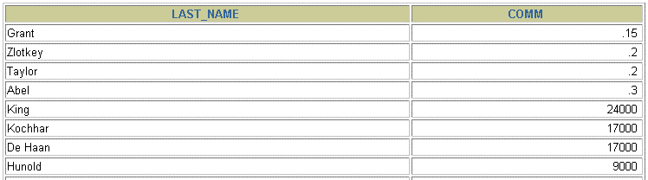
Using the COALESCE Function
SELECT
last_name,
COALESCE(commission_pct, salary, 10) comm
FROM employees ORDER BY commission_pct;
…

Slide 151
Conditional Expressions
Provide the use of IF-THEN-ELSE logic within a
SQL statement
Use two methods:
CASE expression
DECODE function

Slide 152
The CASE Expression
Facilitates conditional inquiries by doing the work of
an IF-THEN-ELSE statement:
CASE expr WHEN [WHEN WHEN | comparison_expr1 comparison_expr2 comparison_exprn | THEN THEN THEN | return_expr1 return_expr2 return_exprn
ELSE | else_expr]
END

Slide 153
Using the CASE Expression
Facilitates conditional inquiries by doing the work of
an IF-THEN-ELSE statement:
SELECT last_name, job_id, salary,
CASE job_id WHEN 'IT_PROG' THEN
WHEN 'ST_CLERK' THEN
1.10*salary 1.15*salary 1.20*salary
WHEN 'SA_REP' THEN
salary END
ELSE
"REVISED_SALARY"
FROM
employees;
…
…

Slide 154
The DECODE Function
Facilitates conditional inquiries by doing the work of
a CASE or IF-THEN-ELSE statement:
DECODE(col|expression, search1, result1
[, search2, result2,...,]
[, default])

Slide 155
Using the DECODE Function
SELECT last_name, job_id, salary,
DECODE(job_id, 'IT_PROG', 1.10*salary,
'ST_CLERK', 1.15*salary, 'SA_REP', 1.20*salary,
salary) REVISED_SALARY
FROM employees;
…
…

Slide 156
Using the DECODE Function
Display the applicable tax rate for each employee in
department 80.
SELECT last_name, salary,
 | DECODE (TRUNC(salary/2000, 0, 0.00, |  | 0),
 | 1, | 0.09,
 | 2, | 0.20,
 | 3, | 0.30,
 | 4, | 0.40,
 | 5, | 0.42,
 | 6, | 0.44,
 |  | 0.45) | TAX_RATE
FROM | employees
WHERE | department_id = 80;

Slide 157
Summary
In this lesson, you should have learned how to:
Perform calculations on data using functions
Modify individual data items using functions
Manipulate output for groups of rows using
functions
Alter date formats for display using functions
Convert column data types using functions
Use NVL functions
Use IF-THEN-ELSE logic

Slide 158
Part Two: Overview
This practice covers the following topics:
Creating queries that require the use of numeric,
character, and date functions
Using concatenation with functions
Writing case-insensitive queries to test the usefulness of character functions
Performing calculations of years and months of
service for an employee
Determining the review date for an employee

Slide 159
Enhancements to the
GROUP BY Clause

Slide 160
Objectives
After completing this lesson, you should be able
to do the following:
Use the ROLLUP operation to produce
subtotal values
Use the CUBE operation to produce cross-
tabulation values
Use the GROUPING function to identify the row values created by ROLLUP or CUBE
Use GROUPING SETS to produce a single result set

Slide 161
Review of Group Functions
Group functions operate on sets of rows to give one
result per group.
SELECT FROM [WHERE
[column,] table condition]
group_function(column). . .
[GROUP BY group_by_expression]
[ORDER BY column];
Example:
SELECT AVG(salary), STDDEV(salary), COUNT(commission_pct),MAX(hire_date)
FROM employees
WHERE job_id LIKE 'SA%';

Slide 162
Review of the GROUP BY Clause
Syntax:
SELECT |  | [column,] group_function(column). . .
FROM [WHERE [GROUP | BY | table condition] group_by_expression]
[ORDER | BY | column];
Example:
SELECT
department_id, job_id, SUM(salary),
COUNT(employee_id)
employees
FROM
GROUP BY department_id, job_id
;

Slide 163
Review of the HAVING Clause
SELECT FROM [WHERE [GROUP BY
[column,] group_function(column)... table
condition]
group_by_expression]
[HAVING [ORDER BY
having_expression] column];
Use the HAVING clause to specify which groups
are to be displayed.
You further restrict the groups on the basis of a limiting condition.

Slide 164
GROUP BY with ROLLUP and
CUBE Operators
Use ROLLUP or CUBE with GROUP BY to produce superaggregate rows by cross-referencing columns.
ROLLUP grouping produces a results set containing the regular grouped rows and the subtotal values.
CUBE grouping produces a results set containing
the rows from ROLLUP and cross-tabulation rows.

Slide 165
ROLLUP Operator
SELECT FROM [WHERE [GROUP BY [HAVING [ORDER BY
[column,] group_function(column). . .
table
condition]
[ROLLUP]
group_by_expression]
having_expression];
column];
ROLLUP is an extension to the GROUP BY clause.
Use the ROLLUP operation to produce cumulative
aggregates, such as subtotals.

Slide 166
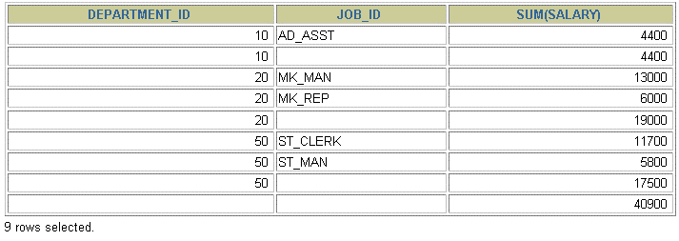
ROLLUP Operator Example
SELECT FROM WHERE
department_id, job_id, SUM(salary)
employees
department_id < 60
GROUP BY ROLLUP(department_id, job_id);
1
2
3

Slide 167
CUBE Operator
SELECT |  | [column,] group_function(column)...
FROM |  | table
[WHERE |  | condition]
[GROUP | BY | [CUBE] group_by_expression]
[HAVING [ORDER BY
having_expression] column];
CUBE is an extension to the GROUP BY clause.
You can use the CUBE operator to produce cross- tabulation values with a single SELECT statement.

Slide 168

CUBE Operator: Example
SELECT department_id, job_id, SUM(salary) FROM employees WHERE department_id < 60
GROUP BY CUBE (department_id, job_id) | ;
1
2
3
4

